Slide 1
Automated Water Pump

Slide 2
Introduction of team members
Member 1:
Name: Risalat Ahmed
ID: 2019000000047
Batch: 51
Member 2:
Name: Tabasum Mim
ID: 2019000000056
Batch: 51
Member 3:
Name: Amit Hassan Ibn Saif
ID: 2019000000088
Batch: 51

Slide 3
Project Objective
Save water from being waste.
Make water sufficient for the world
Utilization of water properly
To make the world better
To make world green.

Slide 4
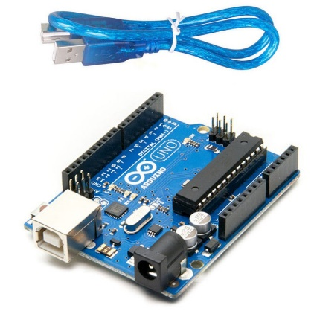
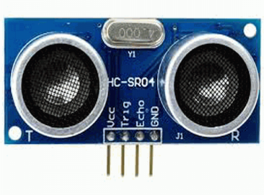
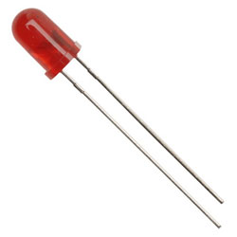
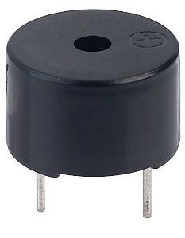
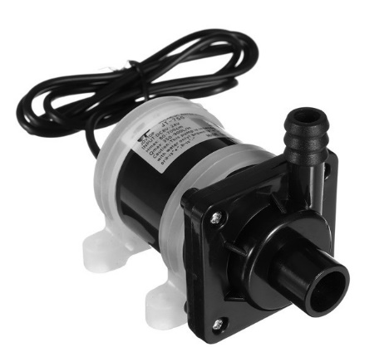
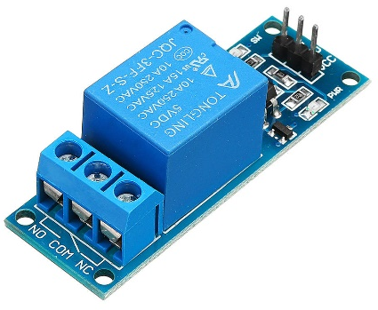
Components Used
Arduino Uno
Sonar Sensor
Led Light
Buzzer
Submersivel water pump
Relay Module

Slide 5
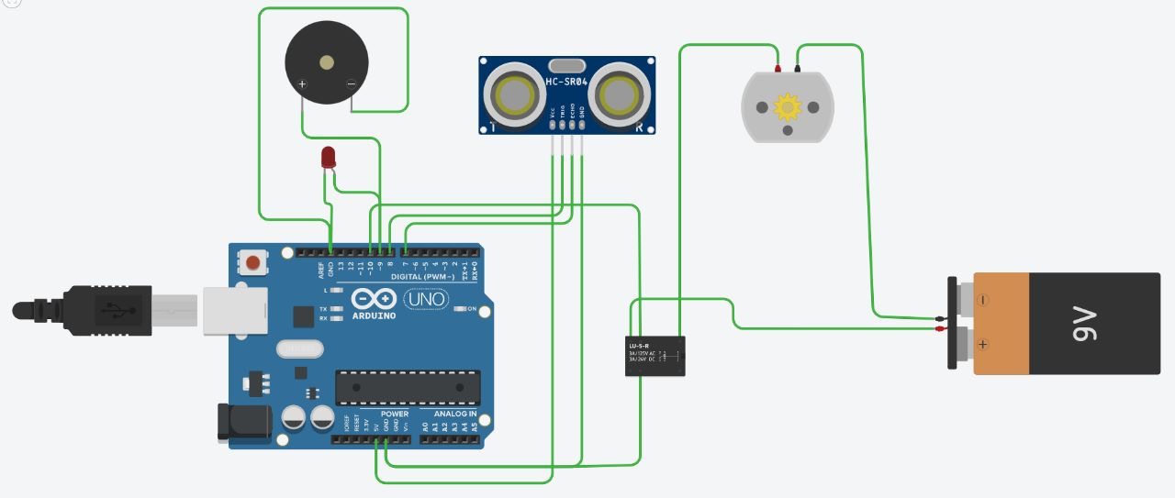
Simulation Screenshot

Slide 6
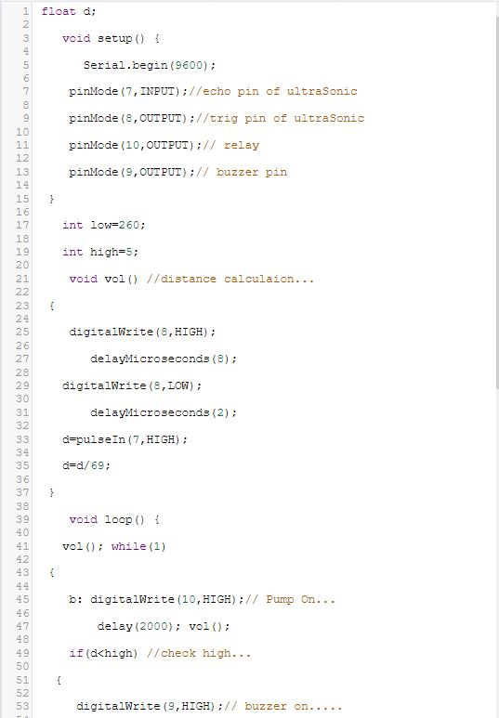
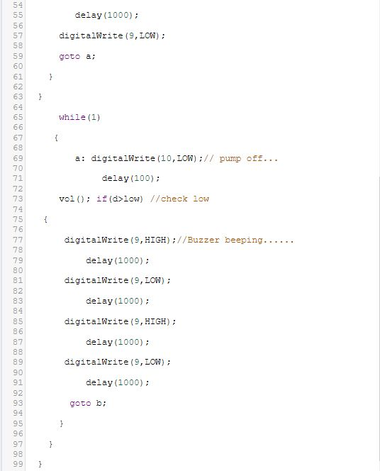
Simulation Screenshot

Slide 7
Functions of the Project
The function of the project is to run water pump automatically (turn on and off) based on water level of the water tank.

Slide 8
Project Outcome
The project's outcome is that, based on our code and the water level of the water tank, the water pump automatically turns on and off. When the tank is filled with water, the water pump turns off, and when the water level is low in the tank, the water pump automatically turns on.

Slide 9
Future Work
The automatic water level controller has a great future scope. By adding a Wi-Fi module through which it can be controlled by mobile applications, by doing so it can be used in big buildings, offices, malls. It also has a bright future in the Agricultural sector.

Slide 10


Save Water, Save Planet Earth, Make the World Green Again

